Slide 1

CONTRACTORS / DEALERS
4th MEETING
| March 17, 2022 | 3-4pm

Slide 2
AGENDA
| Welcome | Patricia Rothwell, Executive Director, EEBC
| Anti-Trust Review
| Introductions | 2 HPAG Action Groups
| Manufacturers, Distributors, Industry Stakeholders
Chair Shawn LeMons, Mitsubishi | Co-chair Pete Perret, GA Larson
| Contractor / Dealers | Nominations
| OUTCOMES FOR TODAY
  | Updates
  | Identify Priorities Cont.
| WHAT DO YOU WANT & NEED TO WORK ON NOW?
  | Contractor/Dealer Priorities & Peer Sharing Ideas
| NEXT MEETINGS –
  | Quarterly Membership Meeting June 16 | 7:30am-9:30am
  | HP Action Group – Contractor/Dealers April 21st 3pm-4pm
| Next Steps & Meeting Dates
| Close Meeting

Slide 3
REFRESHER
YOUR HP RESOURCES WEBLINK
ALL EEBC
HVAC/Heat Pump Action Group Meetings
Webpage Link
https://www.eebco.org/hvac-hp-action-group

Slide 4
UPDATE | Manufacturers, Distributors, & Industry Stakeholders
What Are They Working On?

Slide 5
| Regulatory Policy in 2022
Results | Initiatives
Quarterly Membership Meeting | March 17, 7:30am-9:30am
HOW COVID-19, WILDFIRES, & ENERGY TRENDS EVENTS ARE CHANGING THE HVAC INDUSTRY
  PRESENTATIONS | “The Intersection of Sustainability, IAQ, & Emerging Trends/Technology”
  Trane Technologies • Kandice Cohen, Director Electrification of Heat, Commercial HVAC
  Mitsubishi Electric Trane HVAC • Sam Beason, Sr. Manager of Utilities and Electrification
  Daikin North America/The Heat Pump Store • Jonathan Moscatello, Bus. Development Manager SW
  Carrier West • Roger Yannett, Territory Manager / Residential New Construction Specialist
  | PANEL DISCUSSION & Q&A
XCEL EER & HSPF Rating for HP’s | Meeting Yesterday, March 16, 3-4p
  Impacts HP Equipment Eligibility for Xcel Energy Rebates (see next slide)
  Next | Initiatives
Colorado’s Shared HP Forecast | Working Meeting March 30, 3-4p
  2 scenarios to present to statewide utilities & city jurisdictions for market
  development incentives & support (see following slide)

Slide 6
Results | Xcel Energy & HPAG Manufacturer Meeting RE: EER & HSPF Rating for HP’s
The Agenda
1) Xcel Energy will recap how EER and HSPF relate to heat pump energy savings, Xcel Energy will describe changes proposed in the 60-day notice and why, and which heat pump types these will apply to, Xcel Energy will explain what may change in the 2023 DSM extension and in the 2024-25 DSM filing, manufacturers help Xcel Energy with general questions and thoughts, future plans and wrap up.
EEBC Manufacturers Agreed:
Short-term, these new levels are a move in the right direction and enable a large portion of their premium, ccASHP and ccMSHP, equipment and inverter-driven products to be eligible for heat pump rebates. This is the first step in more changes to come through the 2023 DSM Extension filing, Strategic Issues filing, and 2024-2025 DSM full filing.
Long-term, manufacturers agreed to provide case studies and data analytics from other utilities and programs who have dropped the EER or have alternative methods. Also, requested to “keep an eye” on SEER ratings as additional adjustments are needed because the units “take a big hit”
Next steps:
Manufacturers to follow up with information/data on old ratings vs new EER 2, HSPF 2, & SEER 2 to Xcel re-rated data. Xcel asked EEBC to coordinate the data delivery Xcel.
EEBC (Patricia R) and Xcel Energy (Ann K) set up a follow up meeting.
EEBC Manufacturers Attended:
Doug White, Trane Technologies, Doug.White@tranetechnologies.com
Brady Wooley, Trane Technologies, BWoolley@trane.com
Robert Glass, Daikin, Goodman, Amana, Robert.Glass@goodmanmfg.com
Sam Beeson Mitsubishi, sbeeson@hvac.mea.com
Shawn LeMons, Mitsubishi, EEBC HP Action Group Chair, slemons@hvac.mea.com
Mark Brown, Carrier West, mbrown@carrierwest.com
Patricia Rothwell, EEBC, patriica@eebco.org
Xcel Energy Attended:
Joshua Martin, Joshua.C.Martin@xcelenergy.com
Mike Papula, Michael.P.Papula@xcelenergy.com
Ann Kirkpatrick, ann.kirkpatrick@xcelenergy.com

Slide 7
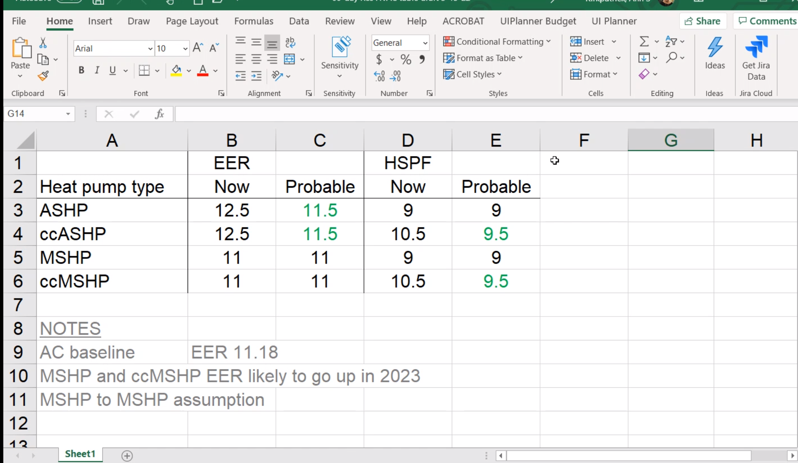
Results | Xcel Energy & HPAG Manufacturer Meeting RE: EER & HSPF Rating for HP’s
As of 3/16/22 Proposed 60-day notice changes
Meeting outcome:
Xcel Energy discovered their baseline was based on HP and switched to AC, giving them more flexibility to lower the EER and HSPF. See recap of proposed chart.

Slide 8

COLORADO’S SHARED HEAT PUMP FORECAST
HEAT PUMP MARKET PENETRATION
& GROWTH TRAJECTORY BY 2030
–––––––––––––––––––––––––––––––––––––––––––––––––––––––––––––––––––––
SOURCE | 4 Stages of Hockey Stick Growth, Bobby Marin, Entrepreneur and Author

Slide 9
UPDATE | Contractor / Dealers
What Needs Identified to Date To Work On?

Slide 10
Contractors / Dealers
3rd Meeting Last Month Requests
| Resources developed from your feedback and requests
  Resource Hub – Recommendations
    Simplify, one-stop-shop, top 3-5 bullets with PPT & recordings
  Fill in training needs gaps not coved by utilities, distributors, & manufacturers currently
    Product knowledge
    Integration and controls work
    MEP’s, intersection of space heating, cooling & H20?
    Leads
    Support for “Entry Dealer” different than for “Existing, Growth, Better ROI Dealer”
  GC Concept/Approach discussion in the marketplace to consider

Slide 11
Contractors / Dealers
2022 Prior Requests To-Date
| Resources developed from your feedback and requests
  1st Project: Sales Tool
    Topic |“Energy Trends are Real & Here Now”…
    Goal | Creates “Sales tipping point” into a HP sales discussion
    | 1 for consumer & 1 for contractor sales team/management
  Influence utility HP rebate programs in 2022
  Find skilled labor for Action Group members’ companies
  Fill in training needs gaps not coved by utilities, distributors, & manufacturers currently
    How to do low-cost Leads Gen when limited consumer awareness. When switch?
    Website turn-key referral support
    How to build your company’s valuation for acquisition by 2030
    Getting the younger generation into your business

Slide 12
Thank You!

