Slide 1
BUILDING PERFORMANCE STANDARDS
IN COLORADO AND DENVER
CHRISTINE BRINKER
EEBC Q4 MEETING

Slide 2
2ND STATEWIDE BPS IN THE U.S.
https://leg.colorado.gov/bills/hb21-1286

Slide 3
BENCHMARKING
STREAMLINED UTILITY DATA
BUILDING PERFORMANCE STANDARD

Slide 4
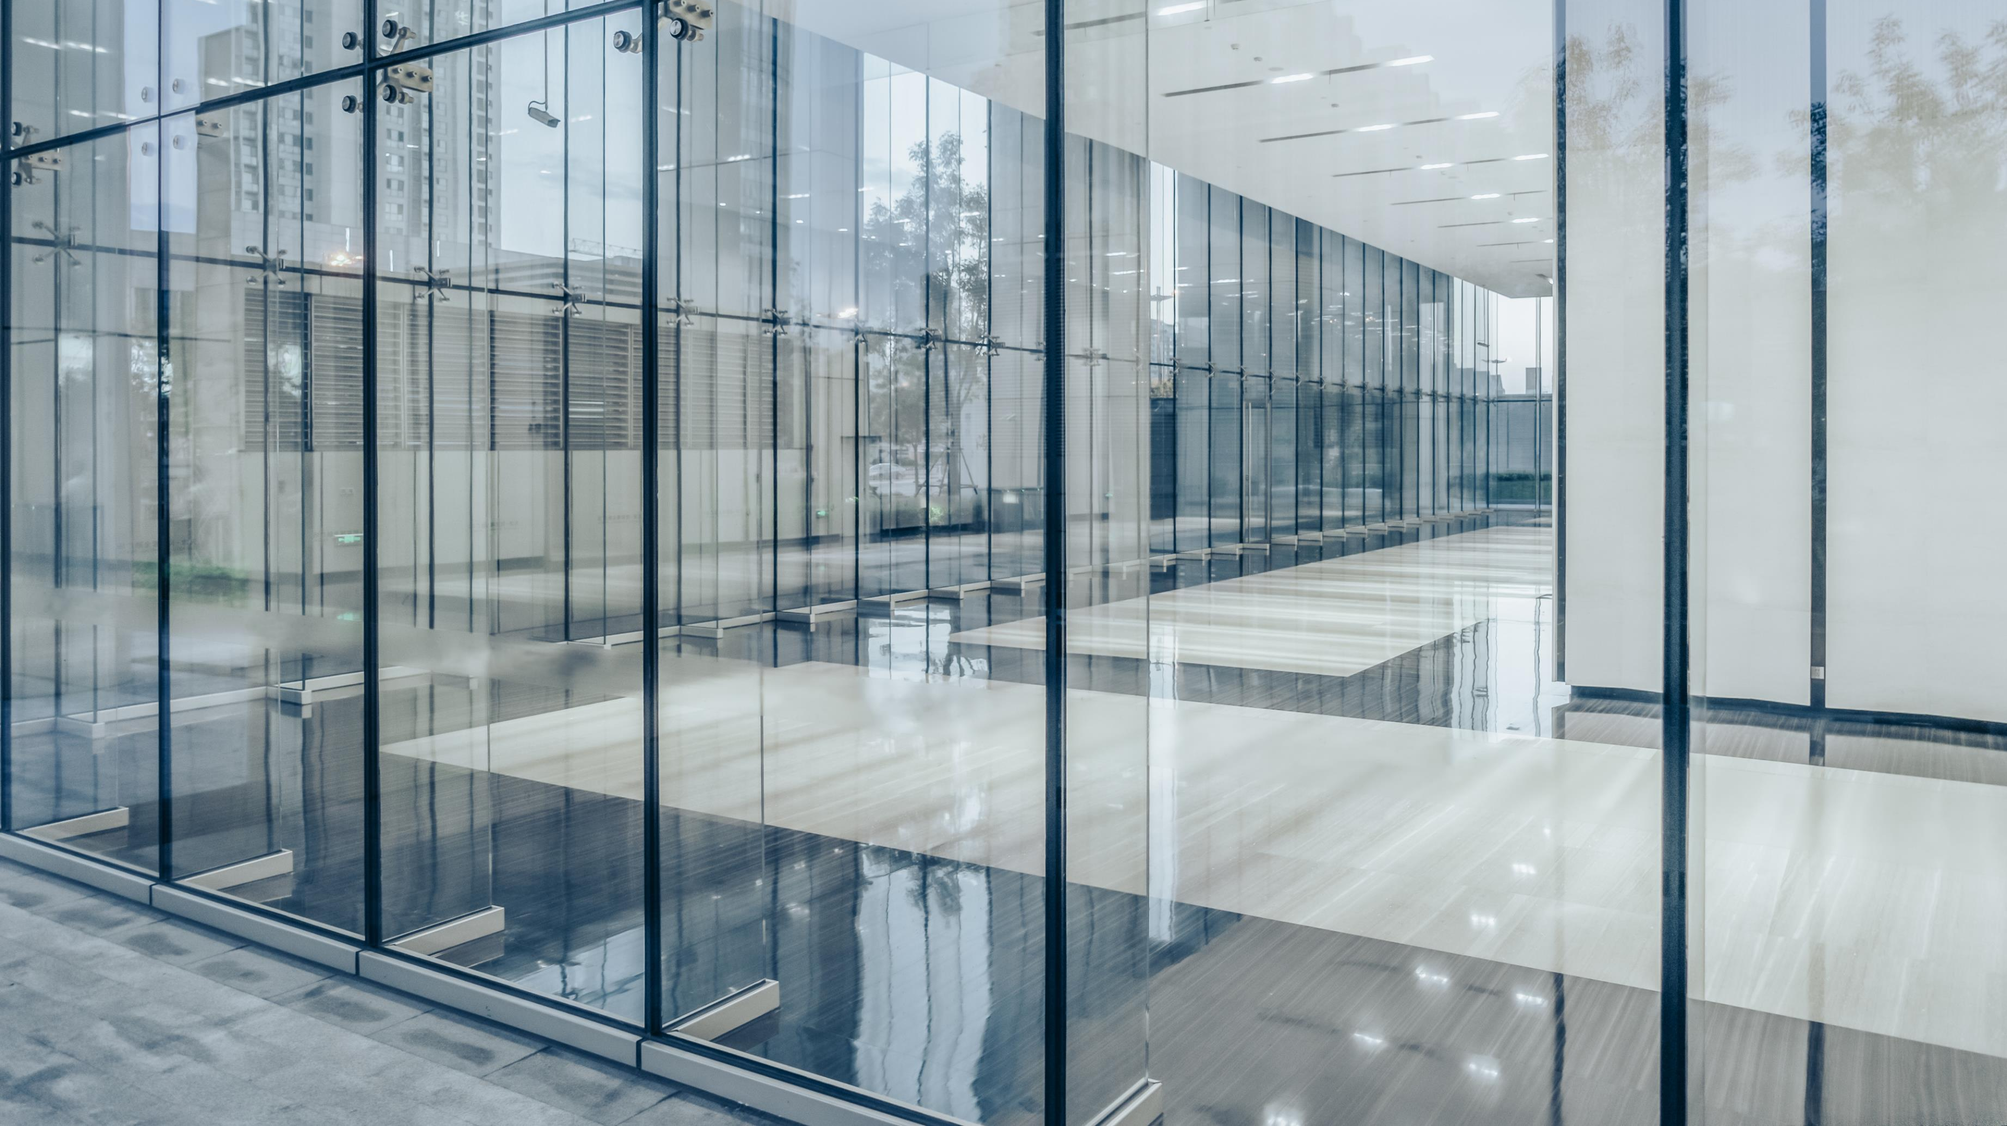
BUILDING PERFORMANCE STANDARDS
7% GHG SAVINGS by 2026, 20% by 2030
TASK FORCE UNDERWAY TO DEVELOP DETAILS
SITE ENERGY USE INTENSITY (EUI) AS THE PRIMARY METRIC
EQUITY, WORKFORCE, RELIABILITY, COST, FLEXIBILITY
AIR QUALITY CONTROL COMMISSION WILL APPROVE FINAL POLICY
RELATIONSHIP TO DENVER’S BPS?

Slide 5
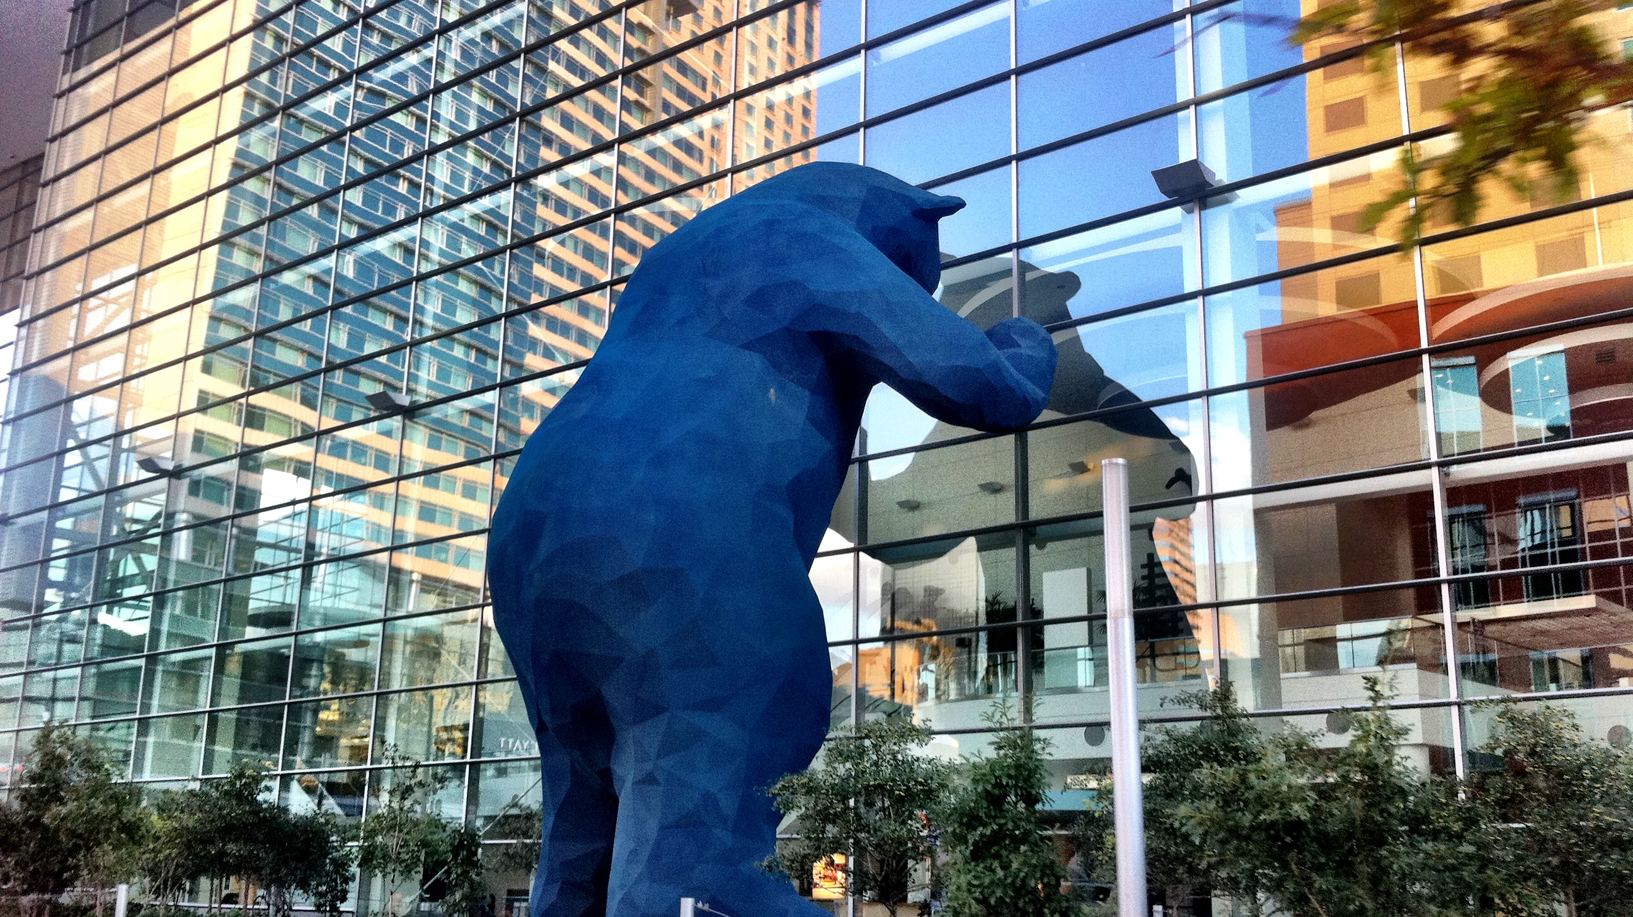
DENVER

Slide 6
100% CONSENSUS
UNANIMOUS APPROVAL BY CITY COUNCIL
UNANIMOUS RECOMMENDATION BY TASK FORCE
80% GHG REDUCTIONS BY 2040 (NEAR NET ZERO)

Slide 7
8
Notes:
Guiding principles
Focus on people and real human lives. Improve overall well-being.
Account for disparate climate impacts and historic racial inequities in Denver. Accelerate positive impacts to low-income and BIPOC communities from a clean energy transition.
Provide for multiple pathways, rather than one-size-fits-all.
Ensure policies are achievable, workable on the ground, effective, and sustainable.
Seek cost-effective strategies.
Seek ‘eager compliance’ among building owners and managers by ensuring solutions are achievable, well supported, and rolled out gradually and strategically. Consider flexible compliance options that are both performance-based and prescriptive.
Recommend incentives with financing to ensure all Denver buildings, and especially low-income communities, benefit from and can comply with the policy.
Allow for flexibility with changing circumstances, such as technologies becoming cost effective.
Minimize unnecessary requirements.
Seek mutually supportive co-benefits (e.g., lowered heating/cooling costs, improved air quality).
Benefit local families and Denver’s economy by providing for robust job training/ workforce. transition and good, livable, new jobs that help alleviate the economic devastation of COVID-19.
Seek to attract new businesses by making Denver one of the greenest cities in the country.
Recognize Denver is unique but don’t reinvent wheels; learn from what is working elsewhere.
We must get to Net Zero Energy to solve climate change for our children’s future

Slide 8
EE / RENEWABLE POLICY
EUI TARGET BY SECTOR, TRAJECTORY BY BUILDING
30% SECTOR-WIDE REDUCTION BY 2030
SOLAR COUNTS 1-FOR-1
FLEXIBILITY AT EVERY POINT
SMALL BUILDINGS <25K SQ FT: CHOICE OF LEDs or SOLAR

Slide 9
ELECTRIFICATION POLICY
2022: EDUCATION
2023: INCENTIVES & PERMITTING PARITY
2024: PARTIAL ELECTRIFICATION AT SYSTEM REPLACEMENT IF COST-EFFECTIVE
FIRST IN THE NATION?
HEATING, WATER HEATING
AT TIME OF SYSTEM REPLACEMENT
“HARDER TO ELECTRIFY” SYSTEMS LATER STARTING IN 2027 (BOILERS, PTACs)
INCENTIVES SWITCH TO UNDER-RESOURCED BUILDINGS

