Slide 1
The Harmonious Co-Existence of Healthy & Sustainable Buildings
Kandice Cohen
March 17, 2022

Slide 2
How Recent Events Are Changing The HVAC Industry: “The Intersection of Sustainability, IAQ/Environmental Quality, & Emerging Technologies. What’s changed: You don’t have to sacrifice one for the other now!”
Emerging Trends/Tech
Building Improvement
IEQ
Sustainability

Slide 3
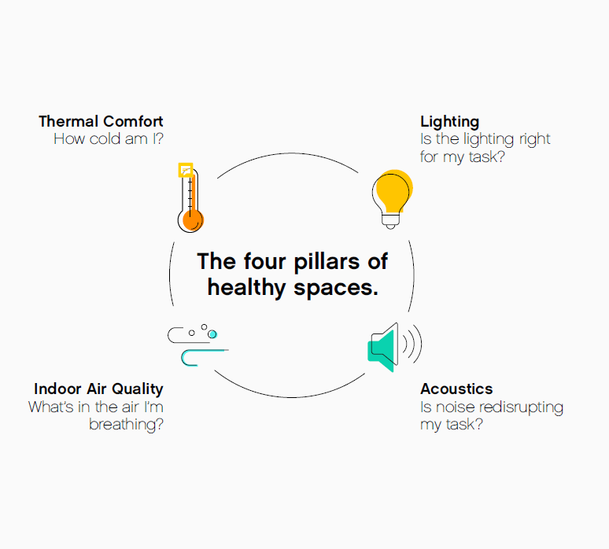
Beyond Indoor Air Quality to Indoor Environmental Quality
Thermal Comfort
How cold am I?
Lighting
Is the lighting right for my task?
Expect a permanent market shift to an increased importance of indoor environmental quality
The role of the home is expected to change to accommodate more working and learning from home
There is an enduring need to balance high-quality indoor environments with energy efficiency
Technology will continue to advance and accelerate to enable healthy and efficient spaces
The 4 Pillars of Healthy Spaces
Indoor Air Quality
What’s in the air I’m breathing?
Acoustics
Is noise disrupting my task?

Slide 4
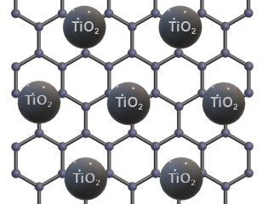
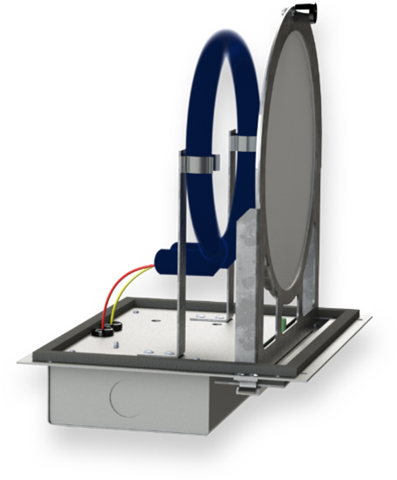
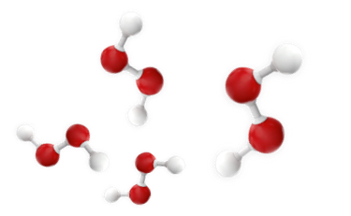
Leading Solutions for Disinfection, Measurement & Control
Photocatalytic
Oxidation
Dry Hydrogen
Peroxide (DHP)
UVC
Irradiation
Improved
Filtration
Antimicrobial
Filtration
Combination of catalyst and UV light that makes hydrogen peroxide and/or hydroxyl ions to break down pathogens.
Naturally occurring H₂O and O₂ in the air is converted to DHP. DHP fills the air in the space and reduces microbes in the air and on surfaces
Combination of Far-UVC (222 nm) claimed to be safe to exposure and/or UVC light to break down pathogens.
Combination of higher efficiency mechanical filters in HVAC systems and in the space can improve reduction of airborne particles.
Zinc, silver and/or copper metal ions embedded in plastic matrix to trap and break down pathogens through contact filtration.
Measurement
& Control
Real-Time Location Services
Circadian Lighting
Contact Tracing
• Track occupants within the space
• Identify people who have come into contact with an infected person
• Collect further information about these contacts
.
Contact Tracing
• Track occupants within the space
• Identify people who have come into contact with an infected person
• Collect further information about these contacts
.
Sensors, analytics and monitoring technologies for closed-loop control of indoor air quality.
Utilizing four different aspects of lighting to control melatonin production and suppression for circadian entrainment
Notes:
Think of the systems running simultaneously within our bodies – a sort of system of systems. They each co-exist harmoniously. The systems that operate within buildings are much like the systems in our body and there are so many ways that buildings impact our health. The COVID-19 pandemic begs for disinfection solutions. These can come in many forms from increasing ventilation to photocatalytic oxidation. There are lot of technologies out there and it’s so important to follow the science to choose the right solution to address the problem. In some cases, the layering together of multiple solutions may lead to the best outcome to improve energy efficiency while maintaining a cleaner space. But buyer beware, there are a lot of new offerings on the market, so be leery of widgets that make grandiose claims that haven’t been proven or tested for the specific problem. Some forms of UV irradiation, UVA and UVB, as an example, do not inactivate viruses, and while UVC irradiation does, it requires modeling for appropriate placement, duration, dosage, and safety protocols to be both safe and effective. With proper use, UVC irradiation can disinfect the air through an HVAC system or within a space and can also sanitize surfaces within unoccupied spaces. We have diligently researched proven technology, and continue to do so, to provide credible subject matter expertise to a marketplace in the midst of the Wild West where new products and unproven claims are abundant. It is important to take a holistic approach – that it is important to first assess the space to identify the right solutions for the unique requirements, then mitigate using many or some of the technologies identified above. Finally, manage and monitor for long-term maintenance and improvement.
There is so much more that we can be doing to promote healthy buildings beyond just disinfection. With real time location services, we can do contact tracing, show free spaces such as conference rooms, and guide people to less occupied areas within a building, all while saving energy.
When thinking of IEQ and the convergence of multiple building systems, it’s important to realize that over half of a building’s energy use is made up of lighting and HVAC. Imagine being able to have full visibility and control of both systems from a single platform – something we’ve offered customers for well over a decade.
We often think of how temperature impacts our comfort, but rarely consider how lighting can affect our health, mood, and well-being. Many people are aware of the photoreceptors in our eyes that control our visual system, our rods and cones. We also have a third photoreceptor in our eyes called the IPRGC or intrinsically photosensitive retinal ganglion cell. The IPRGC in our eyes regulates our circadian rhythm in response to light by suppressing or producing melatonin, known as circadian entrainment. As we evolved outdoors with natural light, the circadian system in our body reacts to the intensity of light, the time of day we receive that light, the duration of time that we receive that light for, and the spectral power distribution of that light. With today’s technology, some LED systems can mimic the outdoor environment indoors, similar to the sunrise to sunset cycle of light, changing in intensity and spectral power distribution to help our bodies regulate melatonin production at the appropriate times. This can not only improve our productivity and support learning, but research in spaces from office buildings, to schools, to the International Space Station show that the right light at the right time can potentially impact our health in positive ways. It’s always prudent to be aware that while using technology that can impact people in positive ways, if used improperly, it’s possible to potentially have negative impact. This is why relying on trusted, credible experts is so important.

Slide 5
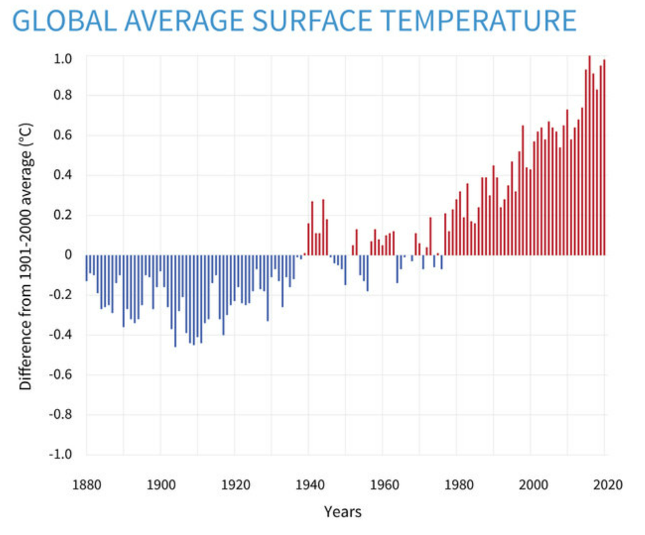
The Sustainability “Why”

Slide 6
Megatrends: Sustainability, Decarbonization, & Electrification
Sustainability
Decarbonization
Electrification of Heat
Offerings

Slide 7
What is Energy Decarbonization?
The energy we utilize in our facilities has different emissions factors.
Scope 1 emissions are directly used in on site (i.e. natural gas, refrigerant emissions)
Scope 2 emissions and are driven by local electric grid factors
Decarbonization is a social, community and business imperative to reduce or offset the emissions required to run operations.
Decarbonization commitments, efforts and milestones resonate with ESG investors and public domain stakeholders.

Slide 8
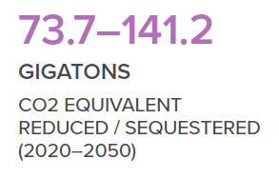
Pillars of Decarbonization
Energy Efficiency
Renewable
Energy
Electrification
Refrigerant Management

Slide 9
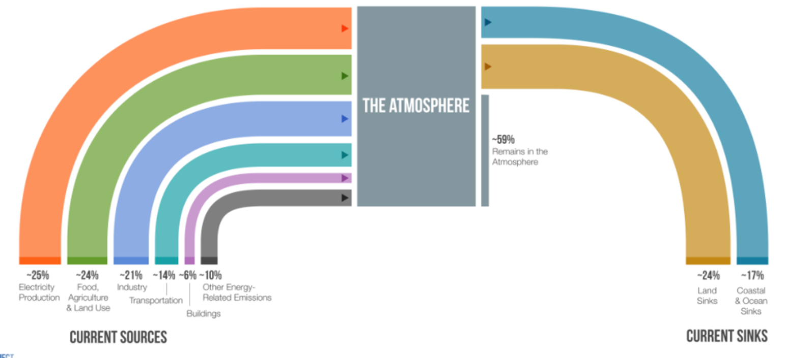
Sources and Sinks
Comfort space heating accounts for 6% of GHG worldwide. Early estimates show that electrifying our comfort space heating infrastructure would reduce GHG by 4%*.

Slide 10
Localized Decarbonization Policies Are Becoming More Prevalent
+
325 Cities have stated a commitment to climate action
+
+
18 of the top 20 most populated cities have set a quantified reduction goal
+

Slide 11
Chillers (Air Cooled & Water Cooled)
Chiller
Chiller + Heat Recovery
Heat Pump
Multi-pipe
OR
Cooling only
Heating or Cooling
Any combination
Heating while Cooling

Slide 12
Light and Large Unitary
Large RTU
Splits
Light RTU
& Splits
Light RTU
WSHP
Ductless/VRF
Cooling Only
Cooling w Elec Heat
Cooling Only
Cooling w Elec Heat
Heat Pump
Heat Pump w Dual Fuel
Heat Pump
Heat Recovery
Heat Pump w Elec Heat
Heat Pump
Heat Recovery

